Slide 1
Miss Walsh’s Classroom Procedures
2017

Slide 2
Bathroom Procedure

Slide 3
Bathroom
Don’t ask
Write your name on board
GO
Erase name when you get back
Notes:
If this becomes a problem we will talk about it and think of something else to do.

Slide 4
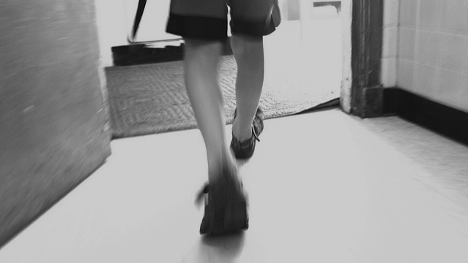
Entering the Classroom Procedure

Slide 5
Entering the Classroom
WALK in quietly
Put belongings away
Check board
Get out materials
Sit at carpet
Do bellwork (if applicable)

Slide 6
Questions Procedure

Slide 7
Questions
Raise your hand if you have something to say
Listen while others are talking, you might have the same question
Wait until the end of the instructions, I might answer your question
Be respectful

Slide 8
Voice Level Procedure

Slide 9
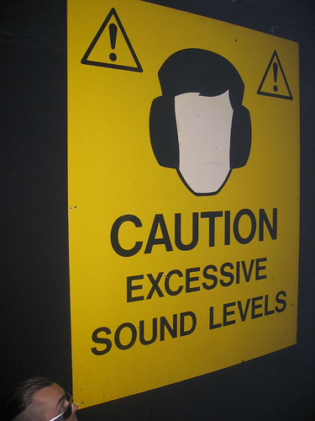
Voice Levels
Voice level 0: No talking
Voice level 1: Whisper Voices
Voice level 2: Talking quietly (only the people around you should here you)
Voice Level 3: Inside voice (the whole class can hear you)
Voice level 4: Outside voice

Slide 10
Getting Drinks Procedure

Slide 11
Getting Drinks
Write name on board
Go fill up water bottle or get drink from fountains
Come right back
Erase board
NOTHING except water in classroom

Slide 12
Homework Procedure

Slide 13
Homework
Homework Policy
Homework packet goes home on Mondays
Turn in in Homework tray
Due EVERY Friday
Late Work Policy
One week late? Full credit.
Anything after? Half credit.
Absent? You have as many days to make it up as you were absent (plus 1 week grace period)
Turn in in Late Work tray (next to Homework tray)

Slide 14
Take Home Folder Procedure

Slide 15
Take Home Folder
Left Side
For your parents to look at and keep at home
Does NOT need to be returned
Right Side
Papers for you to look over with your parents AND return
Weekly homework packet
Homework Folders should be taken home and brought back to school EVERYDAY

Slide 16
Absent Folder Procedure

Slide 17
Absent Folder
Check this folder right when you get back
Everything you missed is in here
Ask if you have questions!

